Slide 2
Modernize your SIEM in the cloud with Azure Sentinel
Abbas Kudrati
Chief Cybersecurity Advisor
Microsoft Asia
https://aka.ms/abbas
Udeesh Millathe
Global Blackbelt – Azure Sentinel
Microsoft Asia
SEC105

Slide 3


76% report increasing security data*
IT deployment &
maintenance
Sophistication of threats
Smart cities
Vehicles
Sensors
Energy systems
Marketplaces
Expanding digital estate
Equipment
t
Partners
44% of alerts are
never investigated
Security Operations Challenges
Citizens
Customers
Supply chains
Too many disconnected
products
On-premises
Manufacturers
Mobile devices
3.5M unfilled security
jobs in 2021
Lack of automation

Slide 4
IT deployment &
maintenance
Sophistication of threats
76% report increasing security data*
44% of alerts are
never investigated
t
Security operations challenges
Too many disconnected
products
3.5M unfilled security
jobs in 2021
Lack of automation
*ESG: Security Analytics and Operations: Industry Trends in the Era of Cloud Computing 2019

Slide 5
Introducing Azure Sentinel intelligent, cloud-native SIEM
Delivers instant value to your defenders

Slide 6
Introducing Azure Sentinel intelligent, cloud-native SIEM
Delivers instant value to your defenders
Scales to support your growing digital estate

Slide 7
Introducing Azure Sentinel intelligent, cloud-native SIEM
Delivers instant value to your defenders
Scales to support your growing digital estate
Uses AI and automation to improve effectiveness

Slide 8
End-to-end solution for security operations
Collect
Detect
Investigate
Respond
Visibility
Analytics
Hunting
Incidents
Automation
Powered by community + backed by Microsoft’s security experts

Slide 9
10 steps to Modernize your SIEM

Slide 10
Visibility

Slide 11


Collect security data at cloud scale from any source
1
AZURE + MICROSOFT 365 Security Alerts, Activity Data
COLLECTORS
CEF, Syslog, Windows, Linux
AZURE SENTINEL
TAXII + MS Graph
Threat Indicators
APIs
Custom Logs
AZURE MONITOR LOG ANALYTICS

Slide 12

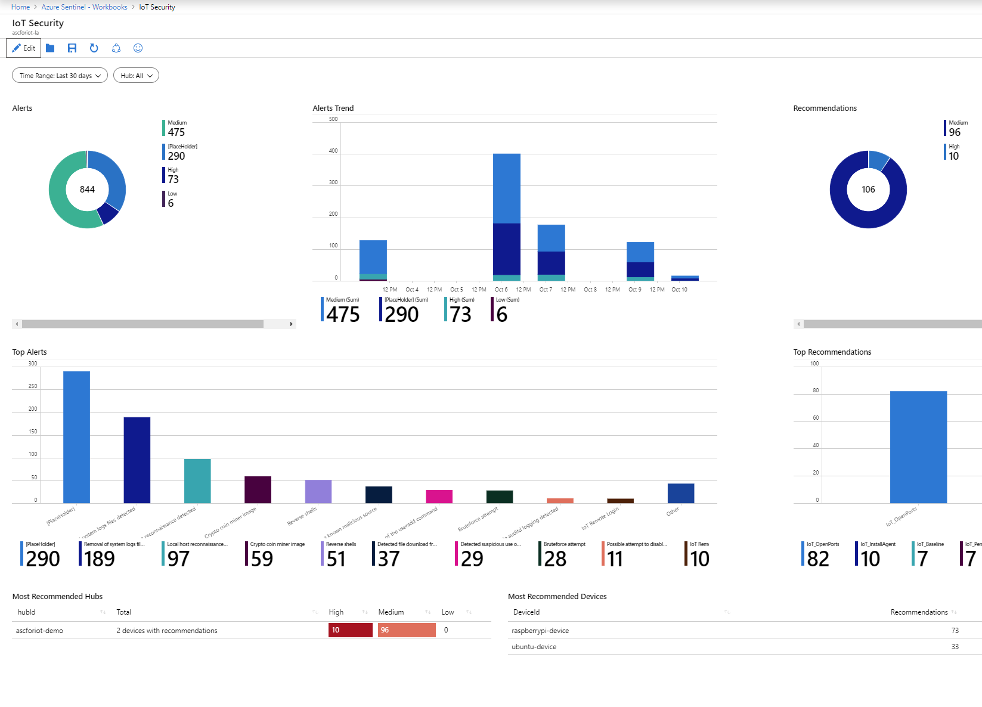
Use workbooks to power interactive dashboards
2
Choose from a gallery of workbooks
Customize or create your own workbooks using queries
Take advantage of rich visualization options
Gain insight into one or more data sources

Slide 13
New data connectors and workbooks announced this week
Barracuda CloudGen Firewall
Citrix Analytics
ExtraHop Reveal(x)
F5 Firewall
One Identity Safeguard
TrendMicro Deep Security
Zscaler Internet Access
Threat Intelligence TAXII Servers (supporting STIX format)

Slide 14
DEMO

Slide 15
$50
?
What data can you ingest in Azure Sentinel at no cost?

Slide 16
$50
A
Azure Activity Logs, Office 365 Activity Logs, Alerts from Microsoft Threat Protection are available at no cost.

Slide 17
Analytics

Slide 18
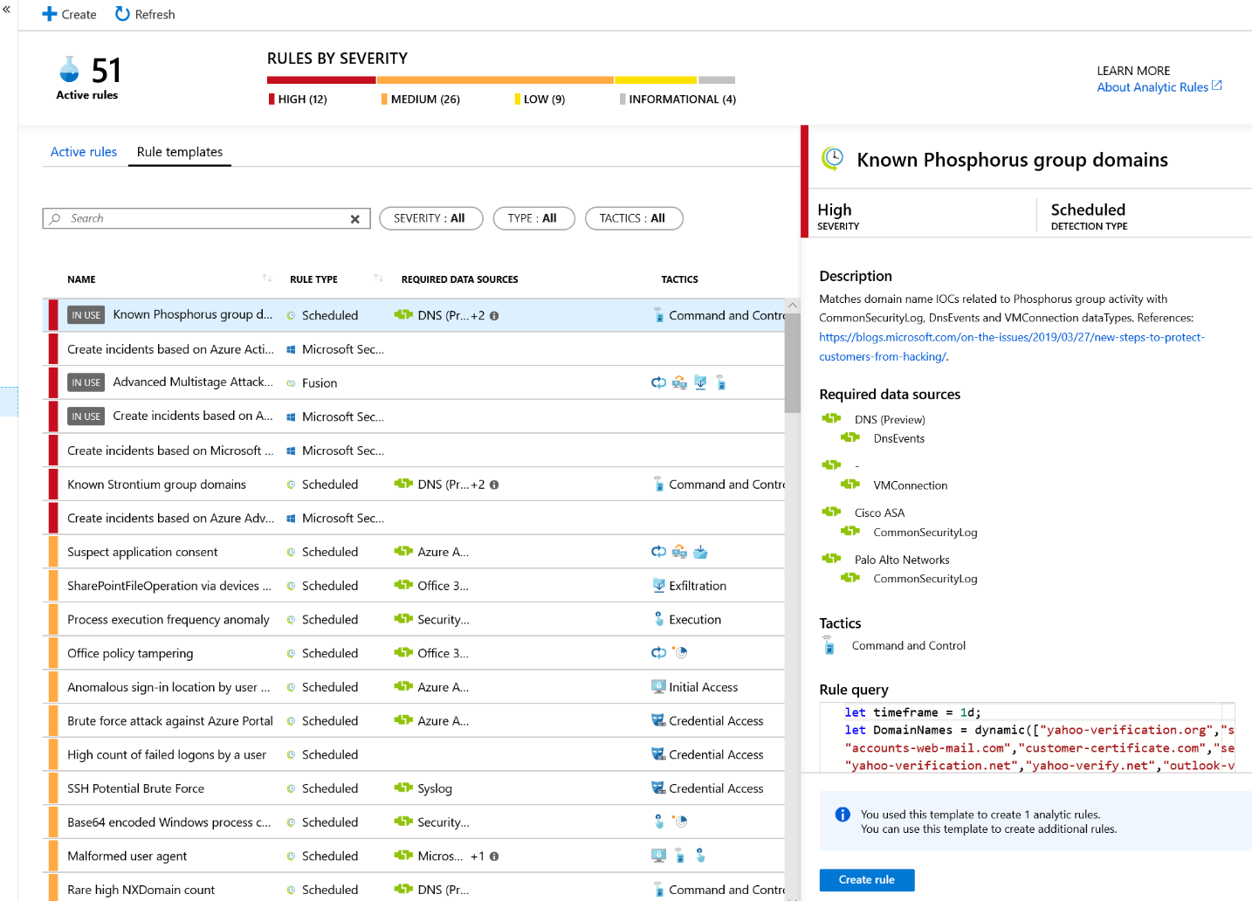
Leverage analytics to detect threats
3
Choose from more than 100 built-in analytics rules
Customize and create your own rules using KQL queries
Correlate events with your threat intelligence and now with Microsoft URL intelligence
Trigger automated playbooks

Slide 19
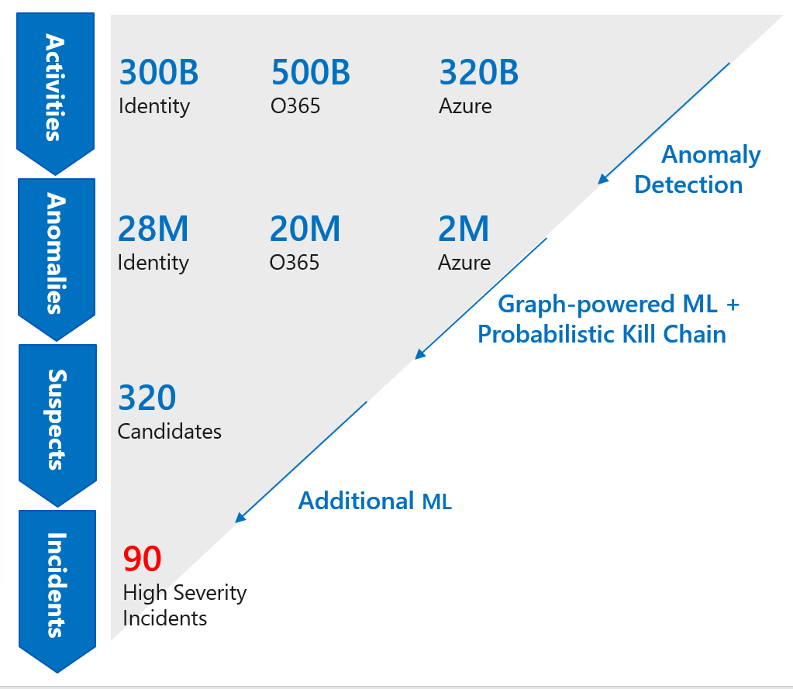
Tap into the power of ML increase your catch rate without increasing noise
3a
Use built–in models – no ML experience required
Detects anomalies using transferred learning
Fuses data sources to detect threats that span the kill chain
Simply connect your data and learning begins
Bring your own ML models (coming soon)

Slide 20
DEMO

Slide 21
$50
?
The Microsoft Threat Intelligence Center names activity groups after ___________.

Slide 22
$50
A
Elements of the period table are used to name activity groups.
A recent blog post, highlighted activity by ‘Phosphorous’ to target users relate to the US presidential campaign.

Slide 23
Hunting

Slide 24
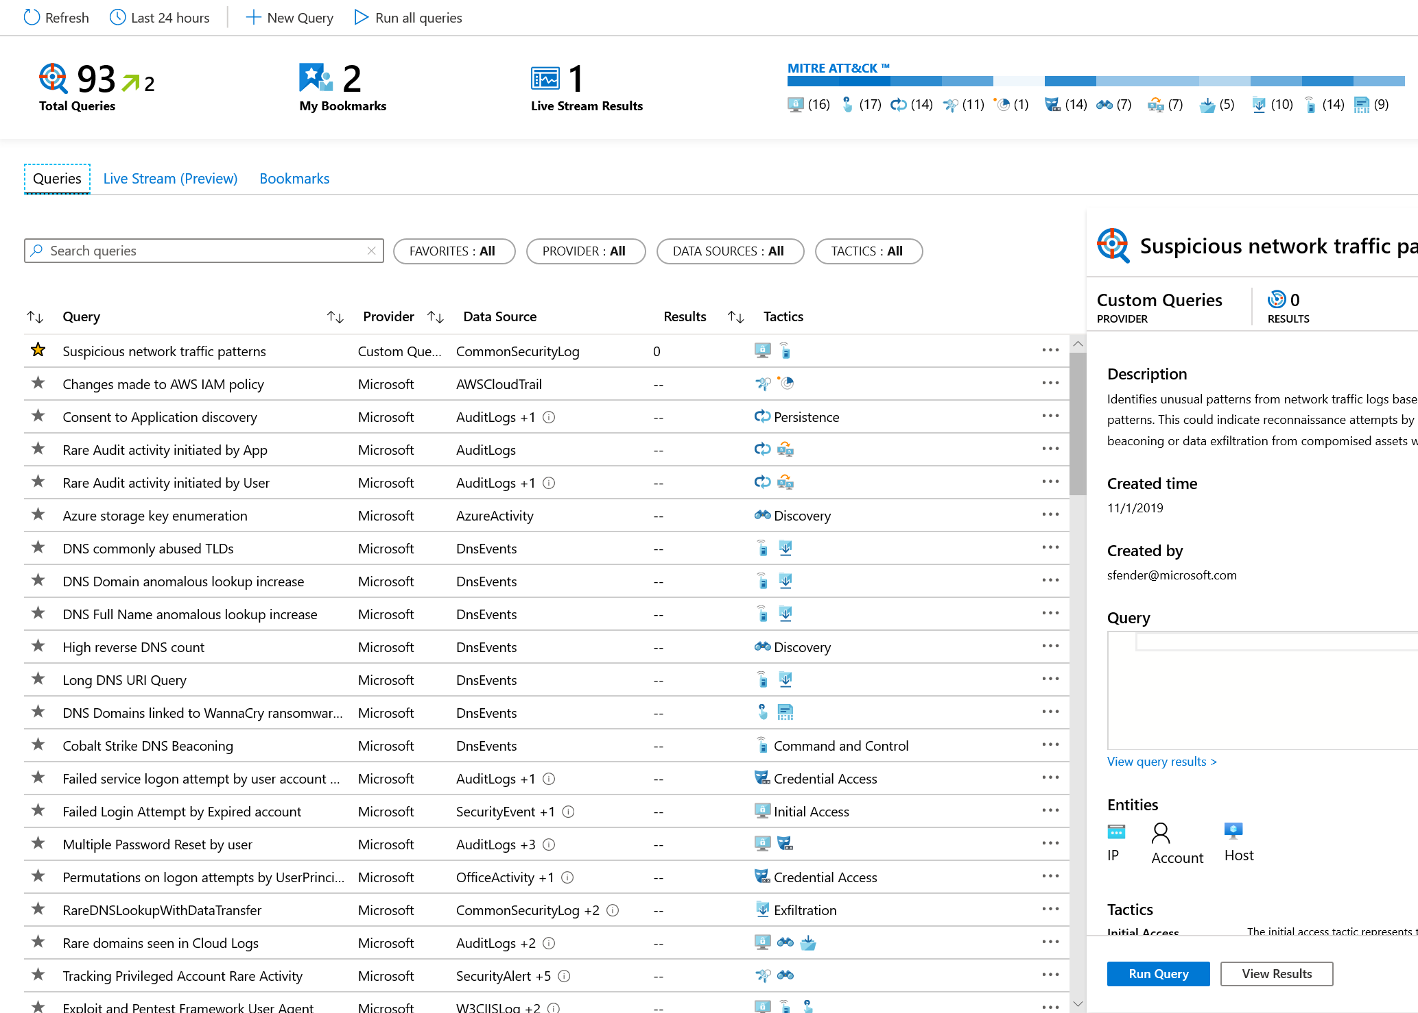
Start hunting over security data with fast, flexible queries
4
Run built-in threat hunting queries - no prior query experience required
Customize and create your own hunting queries using KQL
Integrate hunting and investigations

Slide 25
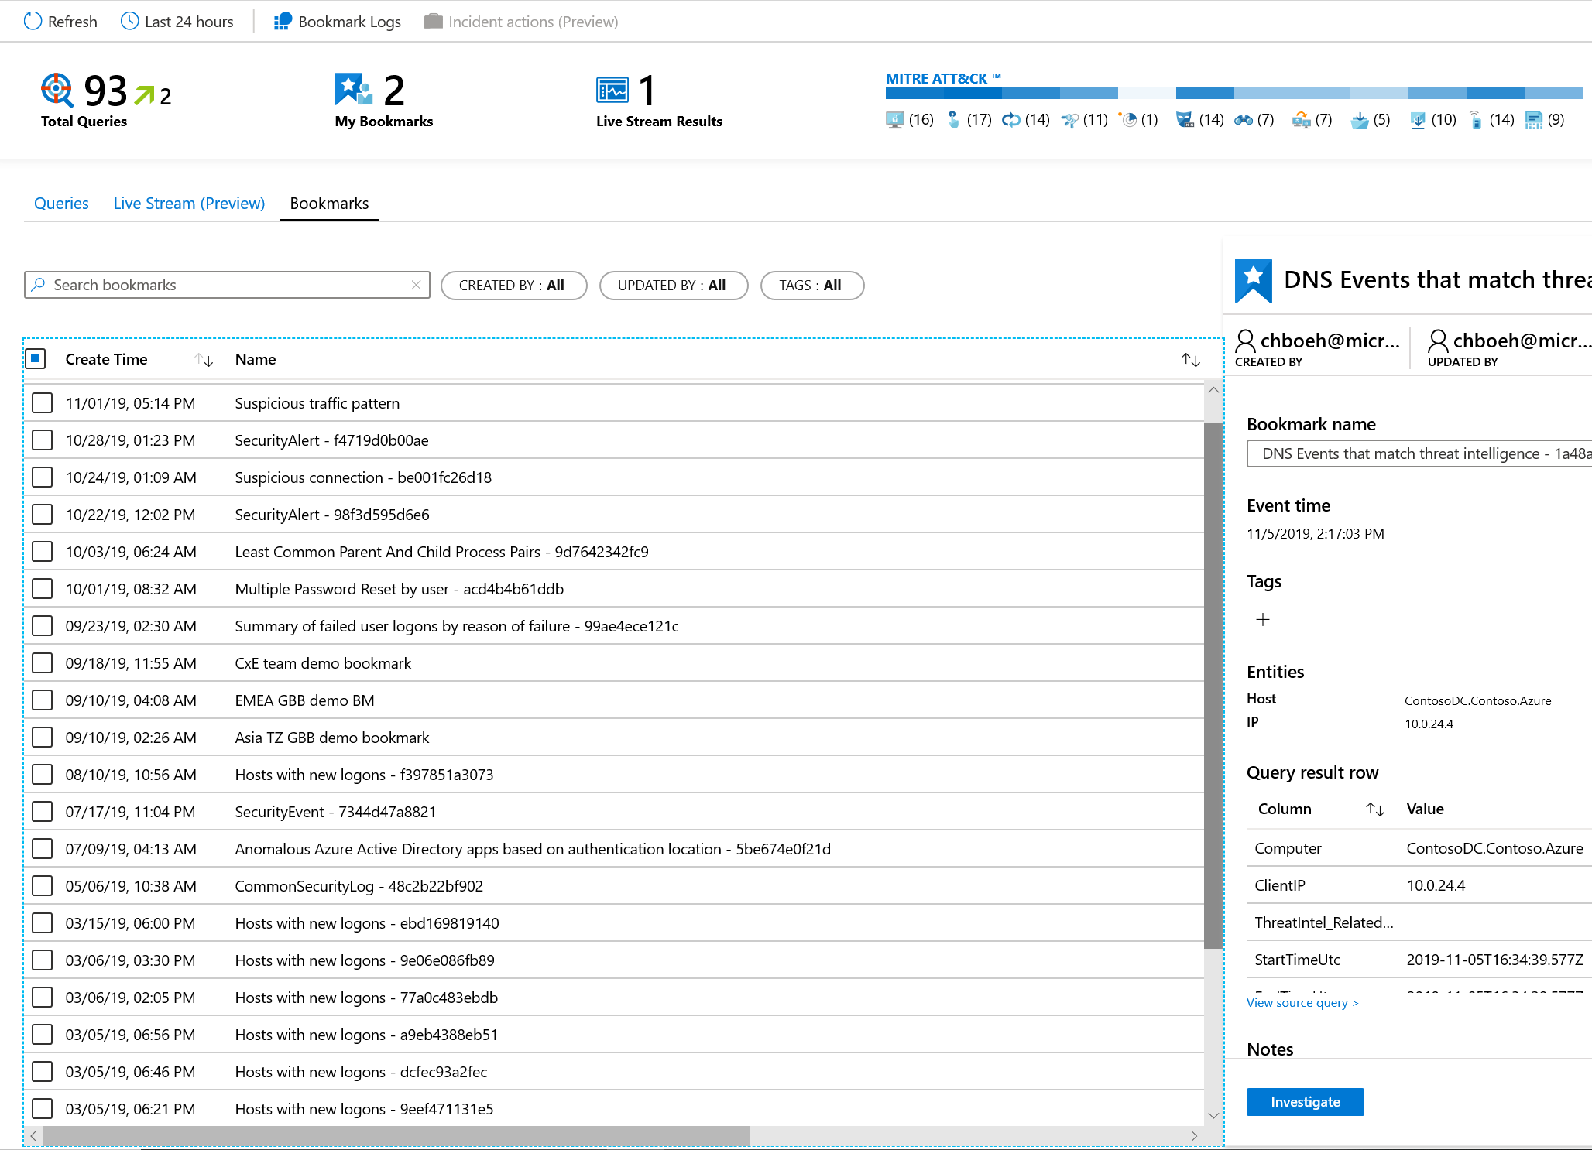
Use bookmarks and live stream to manage your hunts
5
Bookmark notable data
Start an investigation from a bookmark or add to an existing incident
Monitor a live stream of new threat related activity

Slide 26
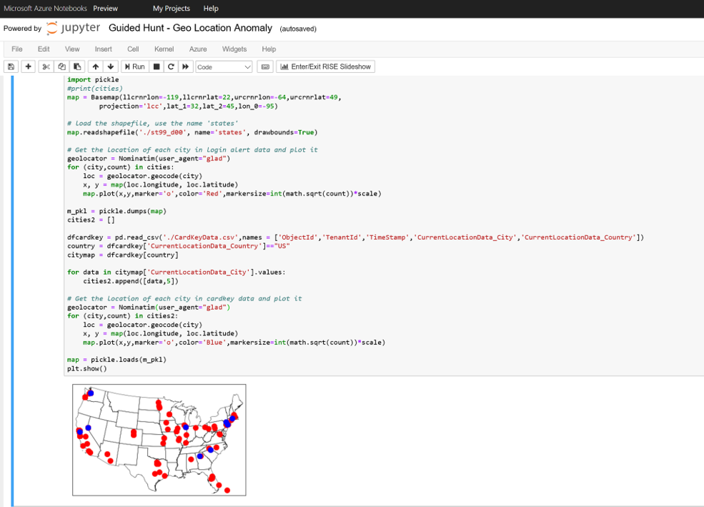
Use Jupyter notebooks for advanced hunting
5
Run in the Azure cloud
Save as sharable HTML/JSON
Query Azure Sentinel data
Bring external data sources
Use your language of choice - Python, SQL, KQL, R, …

Slide 27
DEMO

Slide 28
$50
?
Where can you find and share hunting queries for
Azure Sentinel?

Slide 29
$50
A
Hundreds of contributions, including data connectors, workbooks, analytics rules, queries, notebooks, parsers, functions, and playbooks are available on GitHub.

Slide 30
Incidents

Slide 31
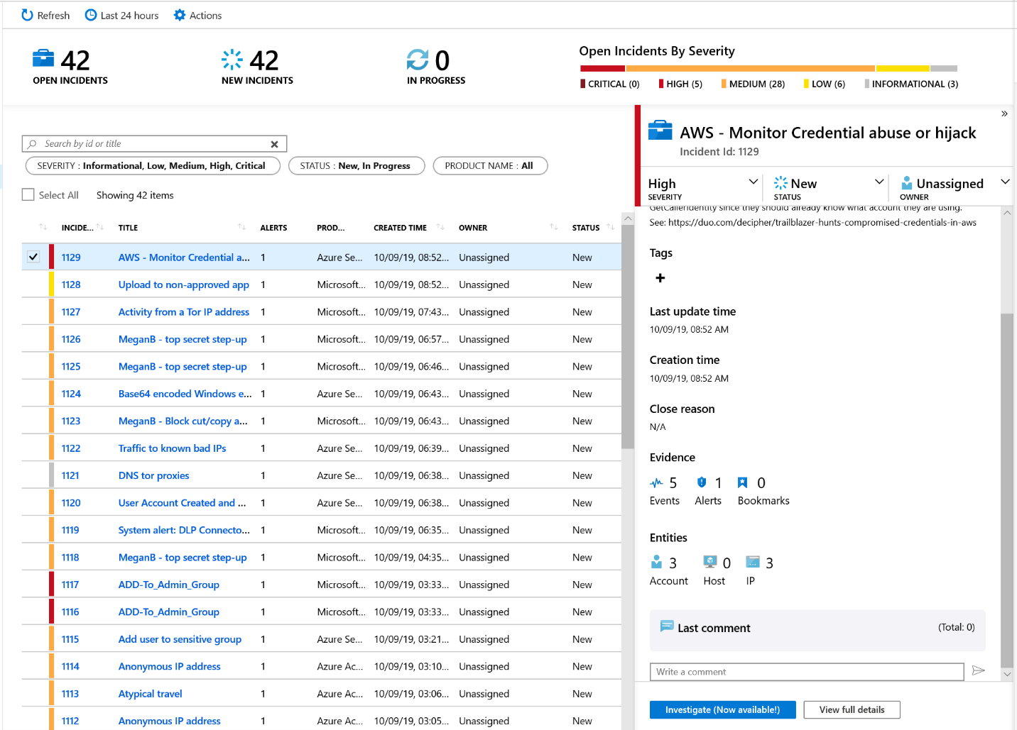
Start and track investigations from prioritized, actionable security incidents
7
Use incident to collect related alerts, events, and bookmarks
Manage assignments and track status
Add tags and comments
Trigger automated playbooks

Slide 32
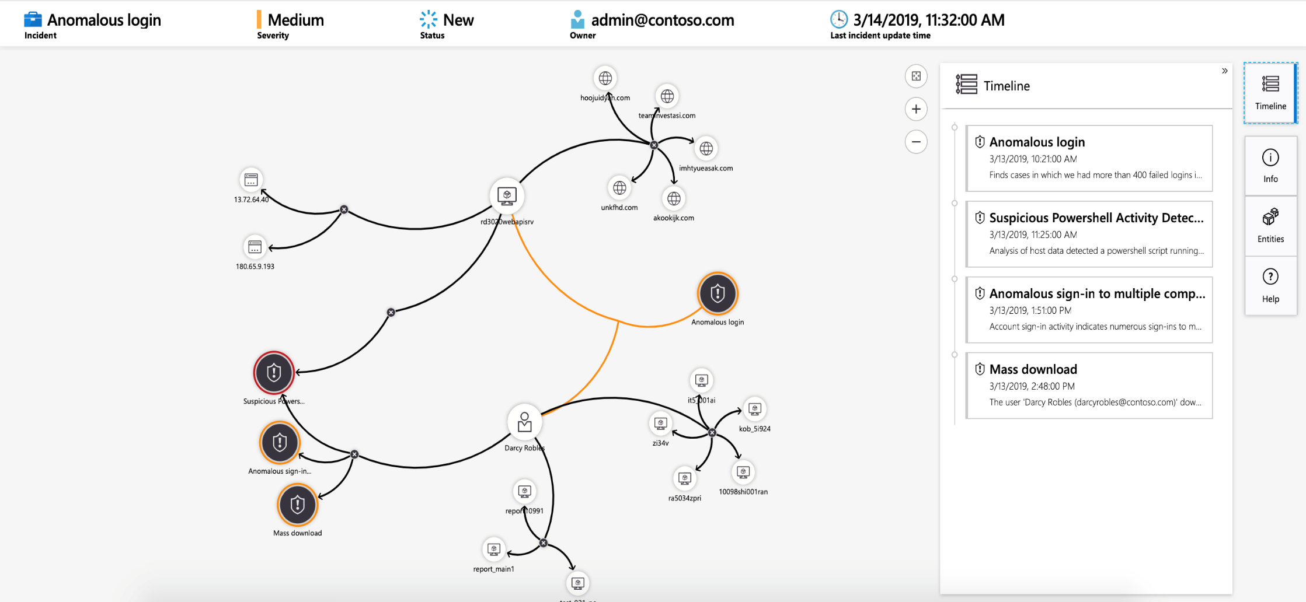
Visualize the entire attack to determine scope and impact
8
Navigate the relationships between related alerts, bookmarks, and entities
Expand the scope using exploration queries
View a timeline of related alerts, events, and bookmarks
Gain deep insights into related entities – users, domains, and more

Slide 33
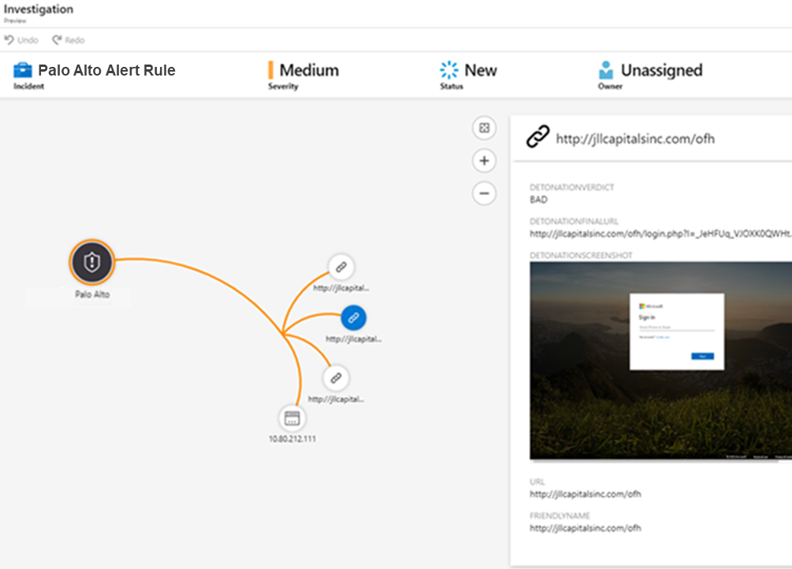
Gain deeper insight with built-in automated detonation
9
Configure URL Entities in analytics rules
Automatically trigger URL detonation
Enrich alerts with Verdicts, Final URLs and Screen Shots (e.g. for phishing sites)

Slide 34
DEMO

Slide 35
$100
?
“Defenders think in ________.
Attackers think in ________.”
-John Lambert, Microsoft Threat Intelligence Center

Slide 36
$100
A
“Defenders think in lists.
Attackers think in graphs.”

Slide 37
Automation

Slide 38
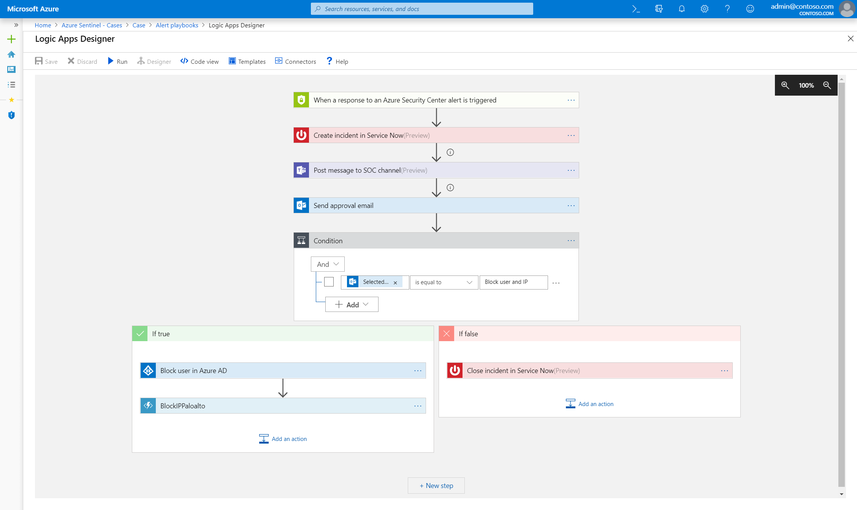
Automate and orchestrate security operations using integrated Azure Logic Apps
10
Build automated and scalable playbooks that integrate across tools
Choose from a library of samples
Create your own playbooks using 200+ built-in connectors
Trigger a playbook from an alert or incident investigation

Slide 39



Example playbooks
Incident Management
Enrichment + Investigation
Remediation
Assign an Incident to an Analyst
Open a Ticket (ServiceNow/Jira)
Keep Incident Status in Sync
Post in a Teams or Slack Channel
Lookup Geo for an IP
Trigger Defender ATP Investigation
Send Validation Email to User
Block an IP Address
Block User Access
Trigger Conditional Access
Isolate Machine

Slide 40
DEMO

Slide 41
Roadmap
Delivered Since Public Preview
Coming Soon
Microsoft and 3P Data Connectors – Defender ATP, Cloud App Security, Zscaler, and More
100+ Build-In Detections – Rule-Based and ML
Investigation Graph and Entities
Workbooks with Improved Data Visualizations
Support for Incident Automation
Embedded Azure Notebooks
Live Stream Monitoring of Notable Events
GitHub Integration
URL Detonation
Additional Data Connectors – More Microsoft Services, Logstash, …
New Built-In Detections – Rule-Based and ML
Additional Detections Powered by Microsoft Threat Intelligence
Bring Your Own ML Models
Threat Intelligence Research, Including Full STIX Objects
Entity Pages – Users, Domains, IPs
And much more…

Slide 42
Azure Sentinel sessions @Ignite 2019
Session Code | Session Title | Date | Time
SEC150 | Modernize your SIEM in the cloud with Azure Sentinel | 11/6 | 3:15 - 4:00 PM
BRK3236 | Get instant value from your SIEM: Best practices for Azure Sentinel | 11/7 | 10:45 - 12:00
THR2174 | Using Azure Sentinel to supercharge your threat hunting | 11/6 | 5:00 - 5:20 PM
THR2159 | Threat Hunting in the Cloud with Azure Sentinel and Jupyter Notebooks | 11/7 | 3:05 - 3:25 PM
Hands-on workshop WRK3033R | Investigate and respond to events with Azure Sentinel | 11/5 11/6 11/8 | 2:15 - 03:30 PM 9:00 - 10:15 AM 9:00 - 10:15 AM

Slide 43


Take actions today—Get started with Azure Sentinel
Start Microsoft Azure trial
Create Azure Sentinel instance
Connect data sources
To learn more, visit https://aka.ms/AzureSentinel

Slide 44
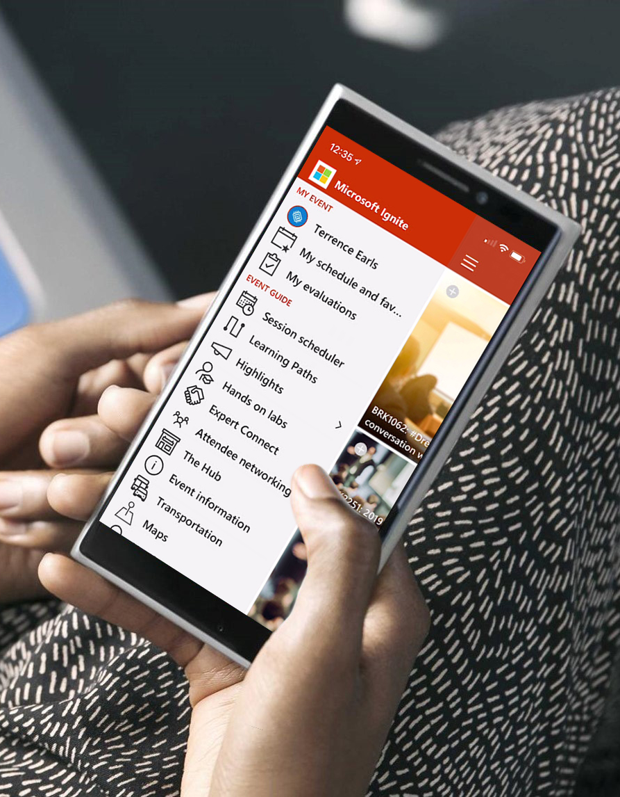
Please evaluate this session Your feedback is important to us!
Please evaluate this session through MyEvaluations on the mobile app or website.
Download the app: https://aka.ms/ignite.mobileapp
Go to the website: https://myignite.techcommunity.microsoft.com/evaluations

Slide 45
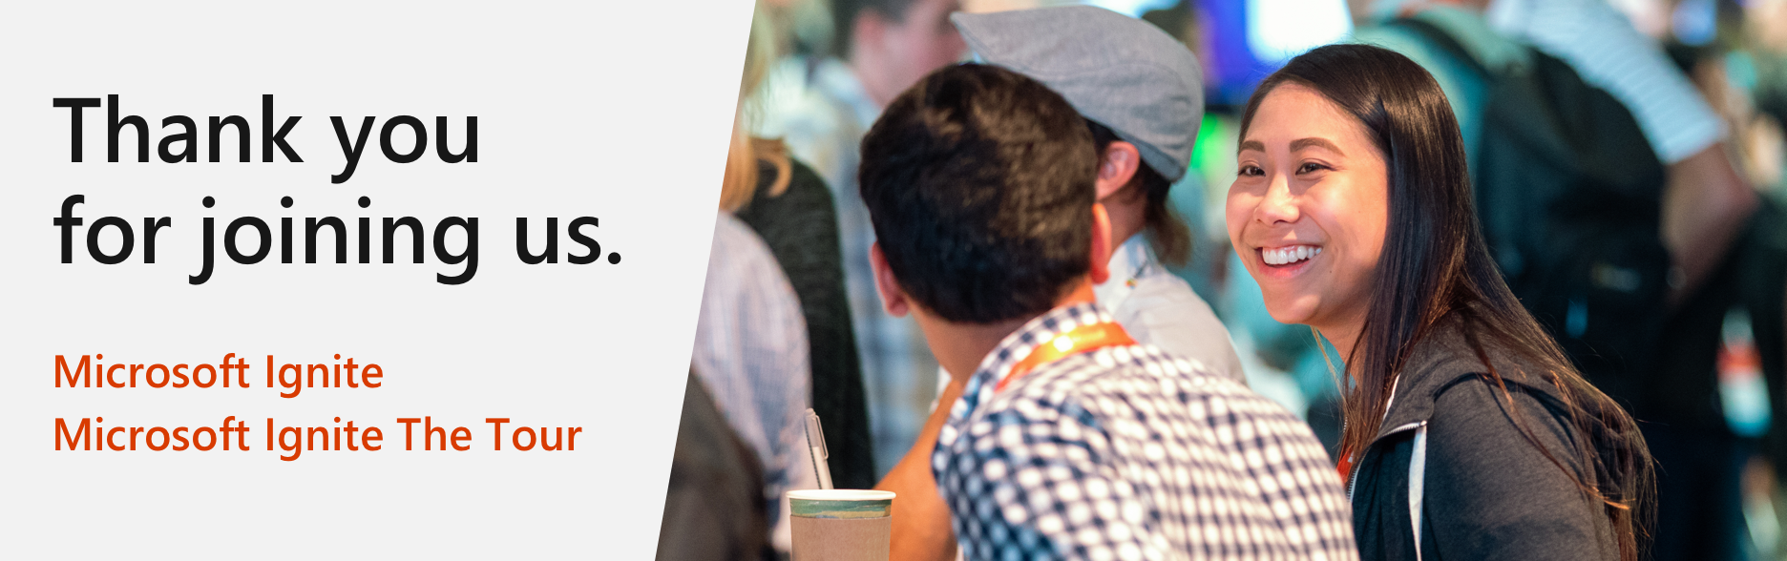
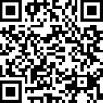
Microsoft Ignite The Tour:
Free Certification Exam Offer
https://aka.ms/Freeexam

Slide 46
Visit aka.ms/MicrosoftIgnite2019/SECI50
Download slides and resources
Access session recordings in 48 hours
Ask questions & continue the conversation
Find this session in Microsoft Tech Community

